Slide 1
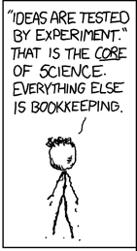
Subjecting travel forecasting to rigorous, scientific testing
April 20 2017
Gregory D. Erhardt Assistant Professor Department of Civil Engineering, University of Kentucky 261 Oliver H. Raymond Bldg., Lexington, KY 40506 859-323-4856 (office), 859-699-1761 (mobile) greg.erhardt@uky.edu
http://transportlab.net
xkcd.com
NSF Workshop:
Advancing the Science of Transportation Demand Forecasting

Slide 2
Be subject to rigorous, scientific testing…
Scientific Method
Travel Forecasting Research
Observation and description of natural phenomenon.
Formulation of a hypothesis to explain the phenomenon.
Use the hypothesis to predict other phenomenon or results.
Perform an experiment or experiments to ensure that results predicted based on hypothesis are achieved in the experiments.
Collect and analyze travel data.
Develop model based on a hypothesis of travel behavior.
Let the MPOs worry about making predictions.
Take the money and run!
Adapted from: Sant, Joseph (2017). The Scientific Method, Hypothesis, Prediction and Test. Retrieved from http://www.scientus.org/Science-Method.html on Apr 14, 2017.

Slide 3
How do we get this right?
Step 1: Make predictions
Ideally competing predictions
Step 2: Test predictions
About the future: A Forecast Repository
About the past: Big Data for Ex-Post Evaluation
What about stuff that hasn’t happened before?
A rubric for evaluating forecasts

Slide 4
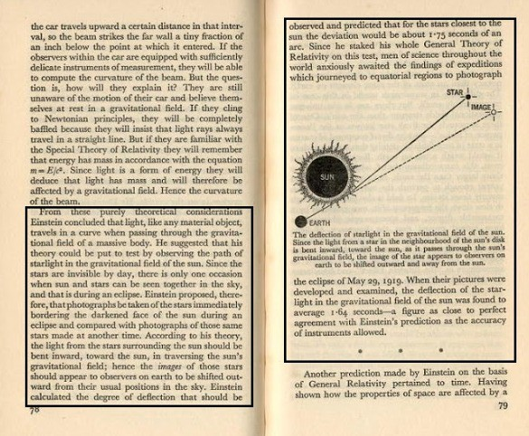
Step 1: Make Predictions
Image from medium.com

Slide 5
1st Principle of Model Evaluation
We build models to predict change. We should evaluate them on their ability to do so.
If you want to know what the world looks like today, collect data…or look out the window!
Implication: Stress less about cross-sectional calibration. Consider pivoting.
Notes:
If you want to know what the world looks like today, collect data. Or look out the window!

Slide 6
2nd Principle of Model Evaluation
We should make testable predictions of important outcomes.
This means:
We should record them.
We should collect the data needed to test them.
im·por·tant adjective
a person who is not a travel modeler cares about it
Notes:
This can mean:
Project-level differences
Big changes (like self-driving cars)
Mike Batty & E. Thames Airport
Probably not:
Broad regional calibration measures
That subdivision down the road

Slide 7
3rd Principle of Model Evaluation
To compare models, we need competing predictions.
An experiment to test whether Model A is better than Model B means controlling for everything but the model.
Implication: We should build “interchangeable parts” models that can be deployed in multiple regions with moderate effort.
Notes:
Consider STOPS. Perhaps MATSIM. I’m looking at you SidewalkLabs…

Slide 8
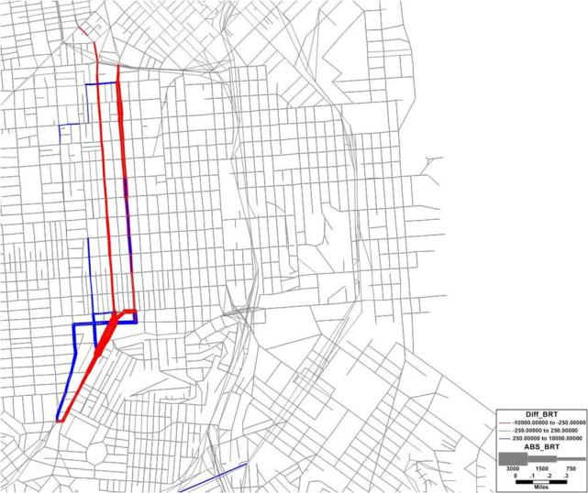
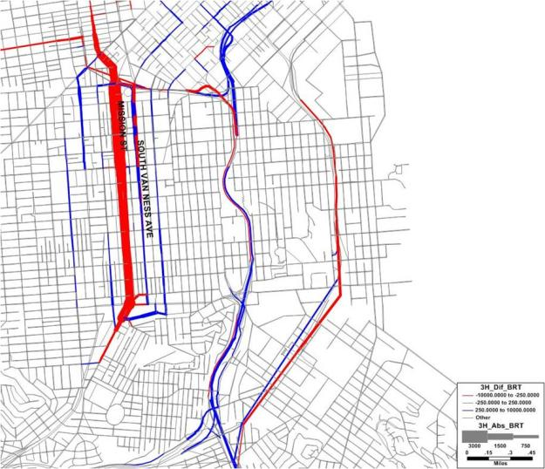
An example:
Modeled traffic volume change for Mission St. bus rapid transit
Static Traffic Assignment
Dynamic Traffic Assignment
Map of Flow Change from Static BRT Test (Red links – flow loss of at least 250 vehicles, Blue links – flow gain of at least 250 vehicles)
Map of Flow Change from DTA BRT Test (Red links – flow loss of at least 250 vehicles, Blue links – flow gain of at least 250 vehicles)
Erhardt, G.D., E. Sall, L. Zorn, D. Tischler, R. Alsup, and N. Nassir. 2013. “Development and Application of a Dynamic Traffic Assignment Model for San Francisco.” In 41st European Transport Conference, September 30-October 2, 2013, Frankfurt, Germany.

Slide 9
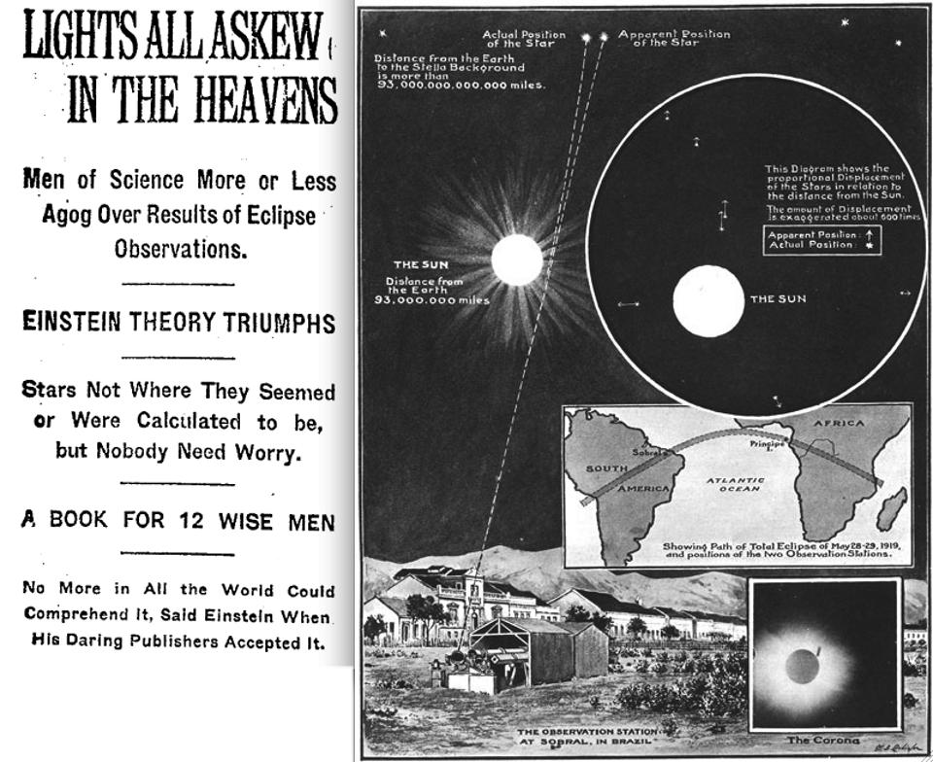
Step 2: Test Predictions

Slide 10
Testing predictions about the future
NCHRP 08-110: Traffic Forecast Accuracy Assessment Research
“The objective of this study is to develop a process to analyze and improve the accuracy, reliability, and utility of project-level traffic forecasts.”
To do this, we are:
Compiling and analyzing existing predicted and actual traffic forecasts.
Developing a Forecast Archive & Information System to record and store new forecasts.

Slide 11
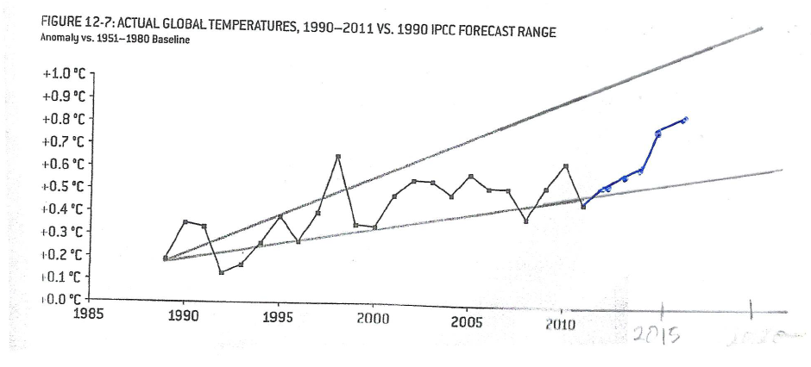
An Example
Silver, N., The Signal and the Noise: Why so many predictions fail, but some don’t, Penguin, 2011.
Updated with 2012-2016 data from: NOAA National Centers for Environmental information, Climate at a Glance: Global Time Series, published April 2017, retrieved on April 25, 2017 from http://www.ncdc.noaa.gov/cag/

Slide 12
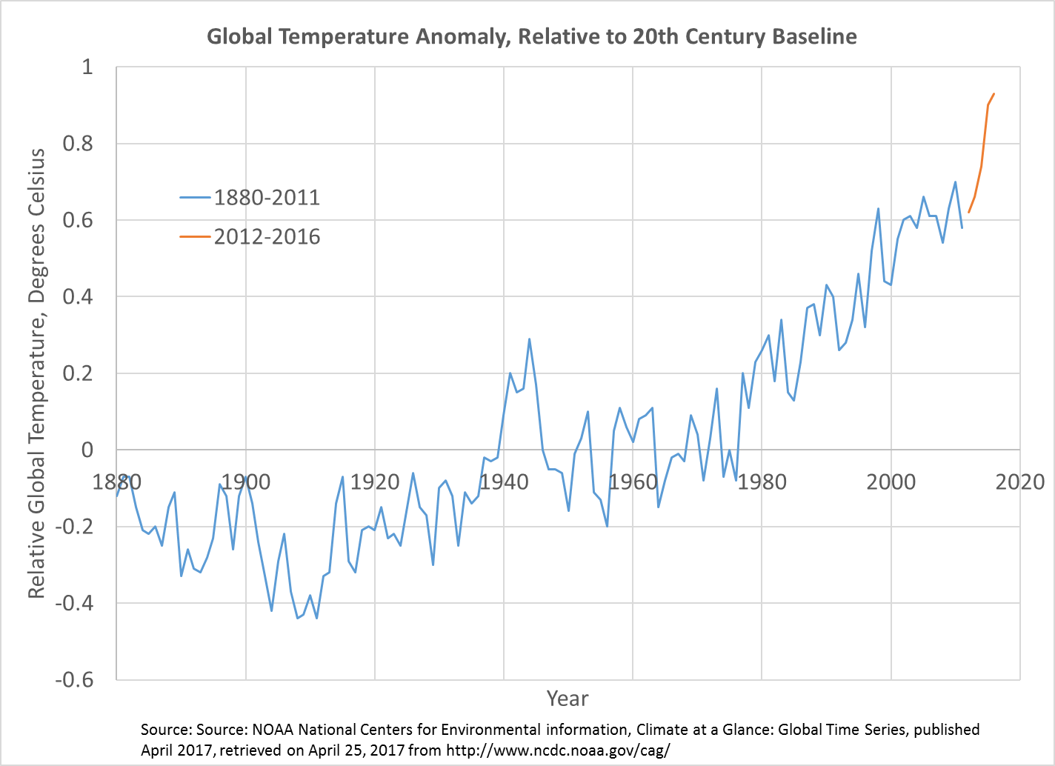
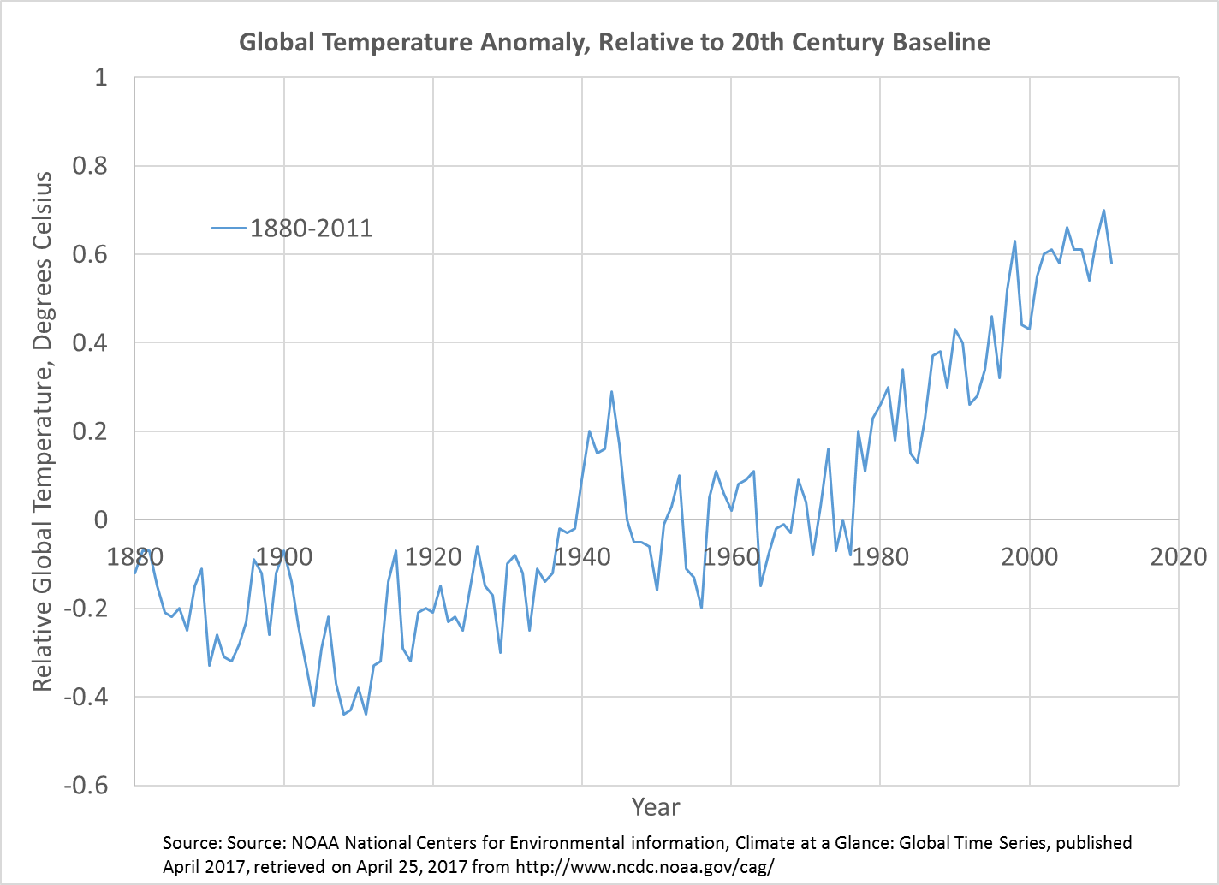
Updating the overall record

Slide 13
Testing predictions about the past
“Because of data limitations, however, changes in behaviour from before to after were not compared.”
Ferdous et al., “Comparison of Four-Step Versus Tour-Based Models for Prediction of Travel Behavior Before and After Transportation System Changes,” Transportation Research Record: Journal of the Transportation Research Board, vol. 2303, no. 1, pp. 46–60, Dec. 2012.
“The lack of availability for necessary data items is a general problem and probably the biggest limitation to advances in the field.”
Nicolaisen, M.S., and P.A. Driscoll. 2014. “Ex-Post Evaluations of Demand Forecast Accuracy: A Literature Review.” Transport Reviews 34, no. 4: 540–57.
Cross-sectional surveys don’t tell us about change!

Slide 14
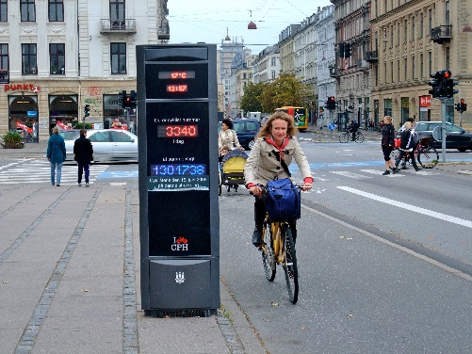
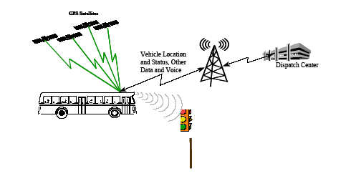
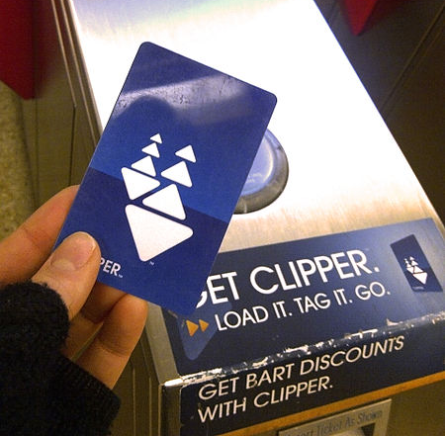
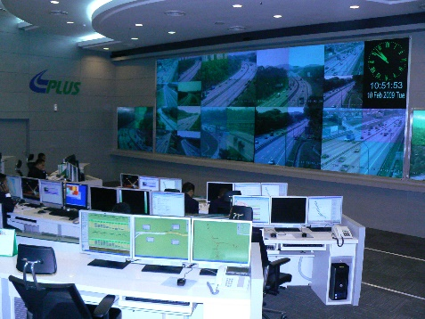
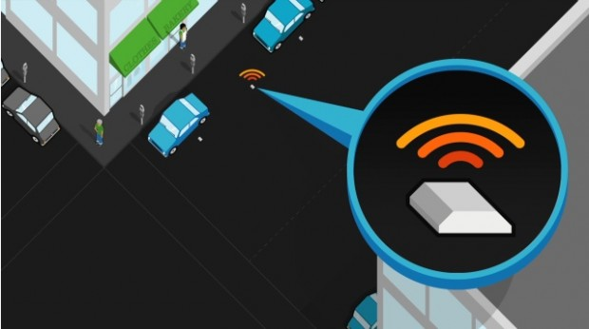
Increasingly, relevant and detailed data are being continuously collected, providing an opportunity to measure the changes that occur in the transport system.
Image from: wikipedia.com
Image from: appliedcomm.com
Image from: commons.wikimedia.org
Image from: commons.wikimedia.org
Image from: sfpark.org

Slide 15
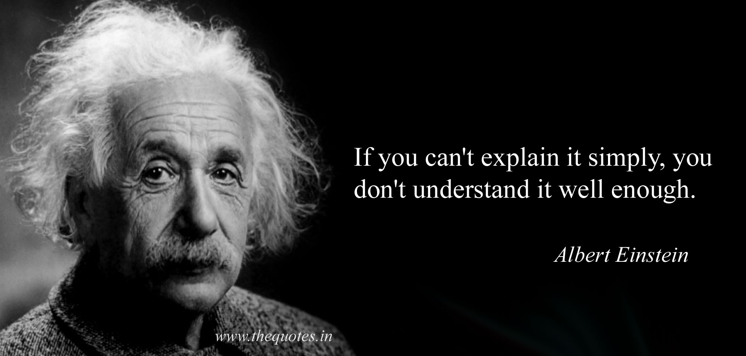
A rubric for evaluating travel forecasts
What about stuff that hasn’t happened before?

Slide 16
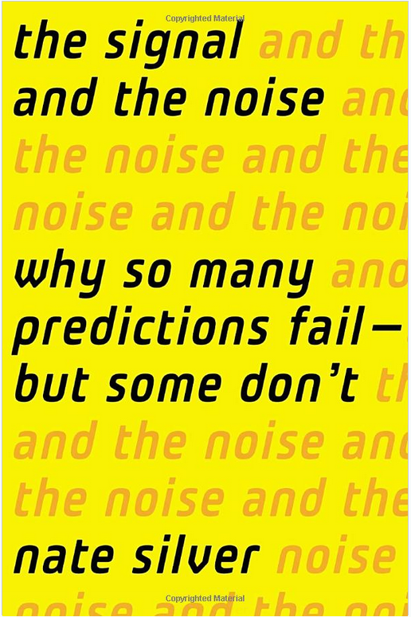
Fields with successful forecasts:
Understand the underlying behavior
Have access to plenty of data
Account for diverse perspectives
Think probabilistically
Consider out-of-sample possibilities
Use feedback to evaluate their predictions
Avoid perverse incentives

Slide 17
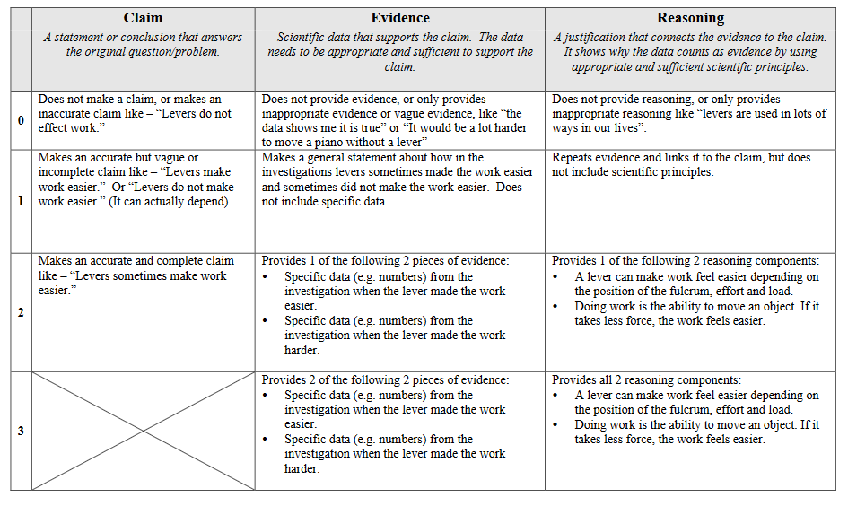
The Claim-Evidence-Reasoning Rubric
National Science Teachers’ Association

Slide 18
IMVAIN Source Reliability Checklist
Independent sources are preferable to self-interested sources.
Multiple sources are preferable to a report based on a single source.
Sources who Verify or provide verifiable information are preferable to those who merely assert.
Authoritative and/or Informed sources are preferable to sources who are uninformed or lack authoritative background.
Named sources are better than anonymous ones.
R. O’Connor, “Practical Tools for Teaching News Literacy,” The Learning Network - Teaching and Learning with the New York Times, 08-Oct-2014. https://learning.blogs.nytimes.com/2014/10/08/guest-post-practical-tools-for-teaching-news-literacy/

Slide 19
PERS Forecast Evaluation Rubric
Category | Most Credible | Standard | Be Suspicious!
Prediction | Makes a prediction. Non-modelers care about the prediction. The prediction can be tested. | Makes a prediction, but that prediction may be vague, hard to test, or of limited importance. | Does not make a prediction (claim), that prediction is untestable, or non-modelers do not care about the prediction.
Evidence | Provides multiple sources of evidence, such as the combination of a forecasting model and the empirical evaluation of similar projects. | Provides evidence in support of the prediction, such as the empirical analysis of similar projects, or travel model forecasts. | Does not provide credible evidence, or that evidence is too narrow or does not apply to the situation. For example, making broad claims from evidence in one city.
Reasoning | Strong explanation for why the prediction makes sense. Notes potential limitations and the implications of those limitations. Considers and evaluates the possibility of out-of-sample future outcomes. | Explains why the prediction makes sense. Notes potential limitations. Considers a reasonable range of possible outcomes. | Does not provide reasoning for why the claim is sound, or reasoning is flawed. Merely refers back to evidence (the model says so). Uses excessive buzz words. Based on a single, deterministic forecast.
Source | Forecaster is independent and objective, or forecaster has a track-record of publicly evaluating their forecasts against actual outcomes. Language is neutral. Model has been back-validated for similar predictions. | Forecaster works for an organization that could potentially be incentivized towards an outcome, but is acting as a professional. Language is neutral. Model has been back-validated. | Forecaster is acting as an advocate, works for an advocacy organization, or has an incentive to forecast a specific outcome. Language may be reactionary or charged.

Slide 20
Be subject to rigorous, scientific testing…
Scientific Method
Travel Forecasting Research
Observation and description of natural phenomenon.
Formulation of a hypothesis to explain the phenomenon.
Use the hypothesis to predict other phenomenon or results.
Perform an experiment or experiments to ensure that results predicted based on hypothesis are achieved in the experiments.
Collect and analyze travel data.
Develop model based on a hypothesis of travel behavior.
Let the MPOs worry about making predictions.
Publish forecasts, not just models.
Take the money and run!
Conduct systematic ex-post evaluations.
While we are waiting to test our predictions, subject them to an agreed-upon evaluation rubric.

Slide 21
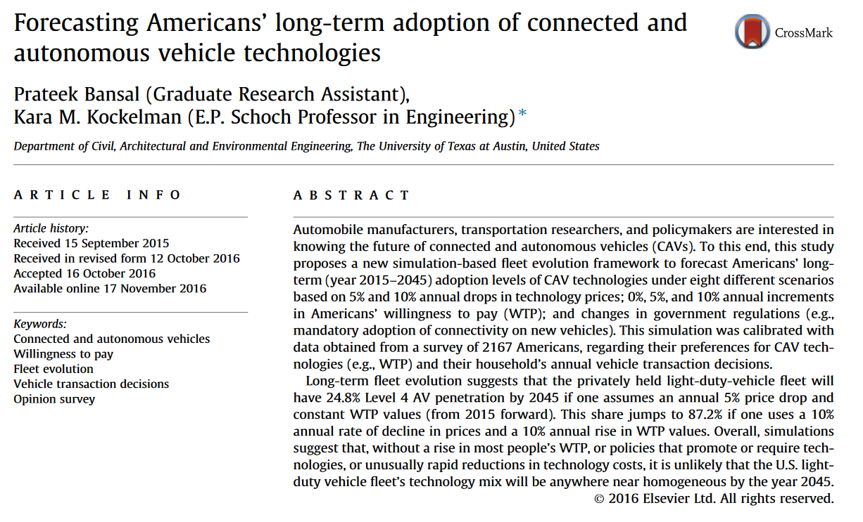

Slide 22
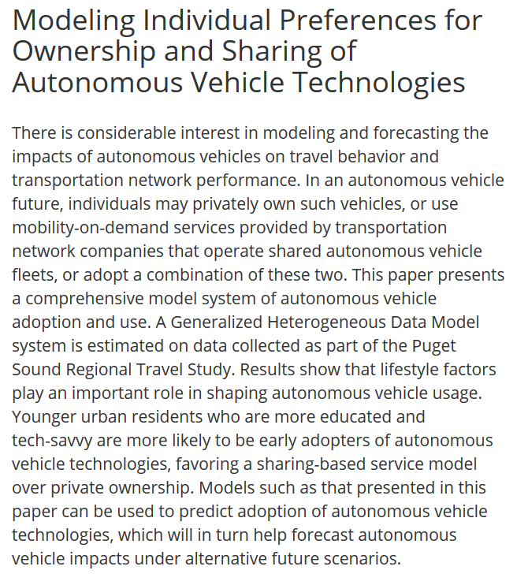
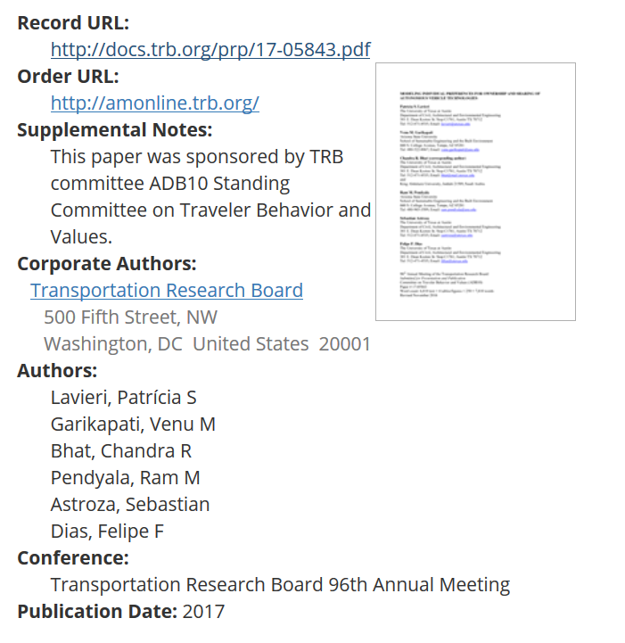

Slide 23
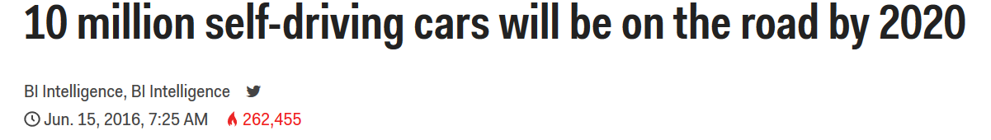
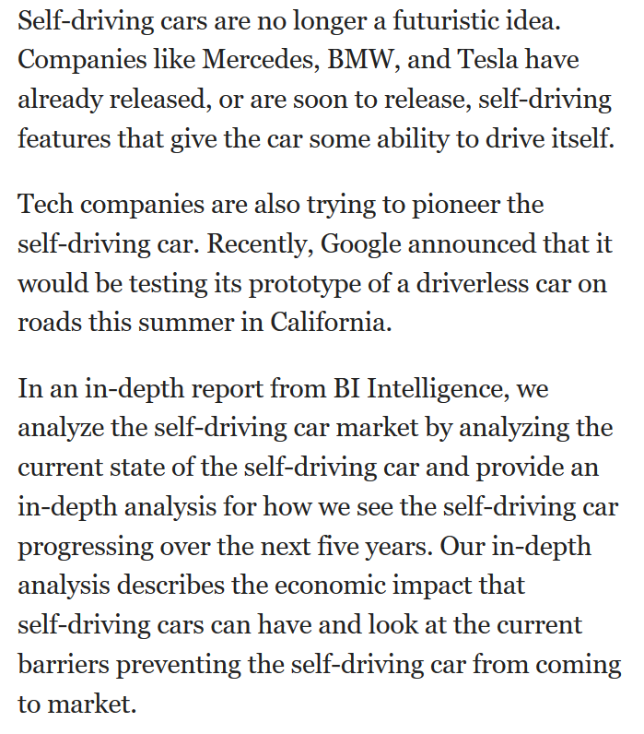
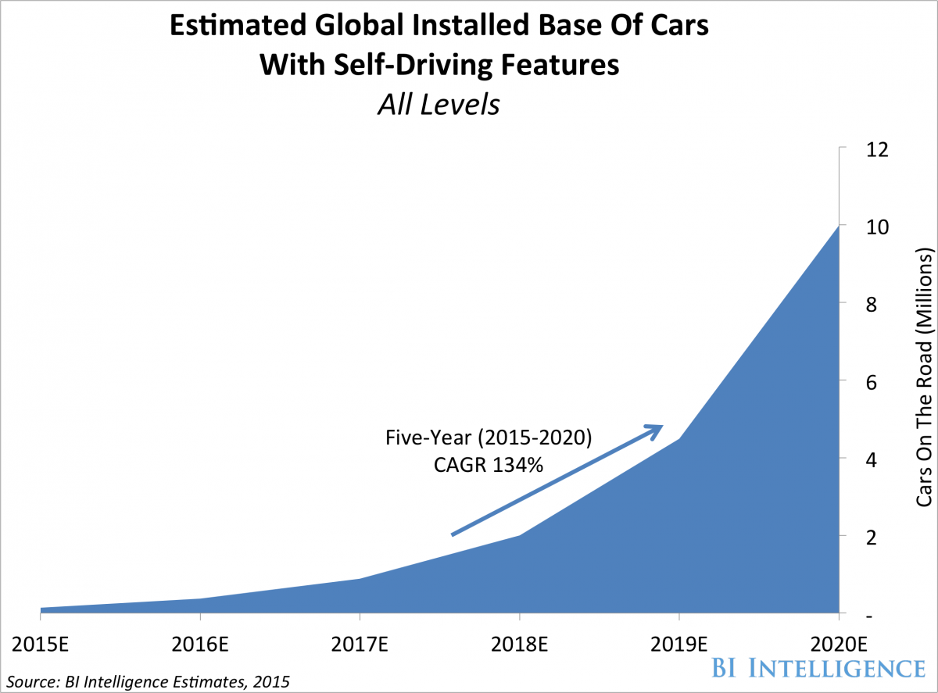

Slide 24
Extras

Slide 25
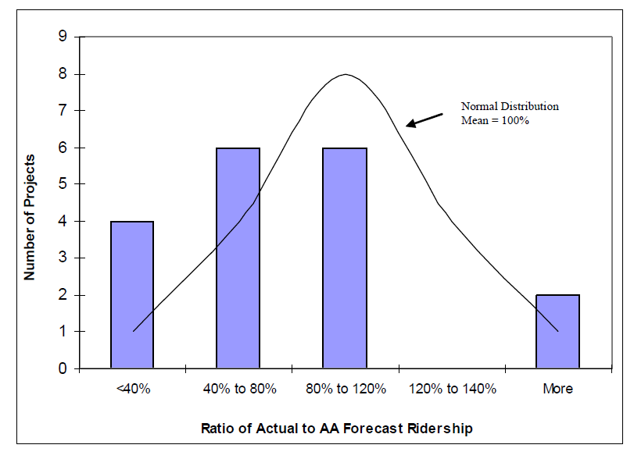
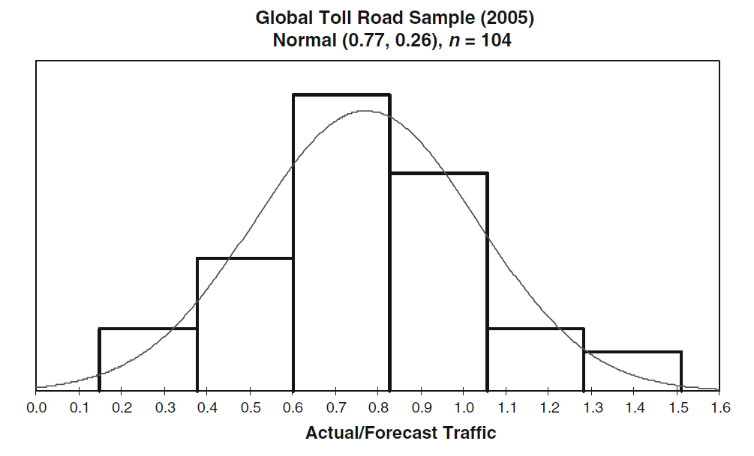
Once in a while, we do look back…
US urban rail:
25% lower than forecast
Global toll roads:
23% lower than forecast
Federal Transit Administration, Office of Planning and Environment, and Vanasse Hangen Brustlin, Inc. 2008. The Predicted and Actual Impacts of New Starts Projects -- 2007: Capital Cost and Ridership.
Bain, R. 2009. “Error and Optimism Bias in Toll Road Traffic Forecasts.” Transportation 36, no. 5: 469–82.
Notes:
Possible problems: Technical Problems, Optimism bias, Selection bias

Slide 26
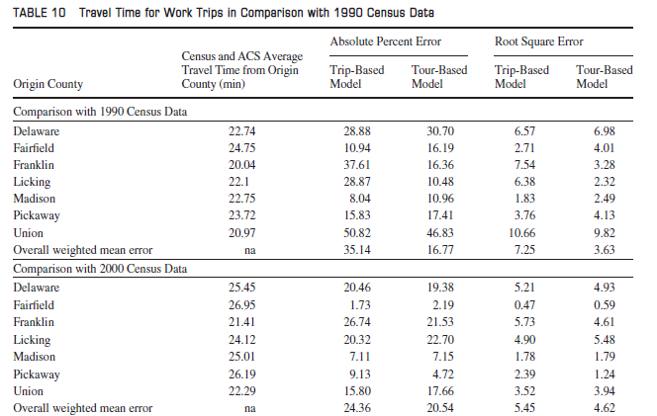
Comparing Models
Trip-Based vs Tour-Based Models in Columbus
“Because of data limitations, however, changes in behaviour from before to after were not compared.”
N. Ferdous et al., “Comparison of Four-Step Versus Tour-Based Models for Prediction of Travel Behavior Before and After Transportation System Changes,” Transportation Research Record: Journal of the Transportation Research Board, vol. 2303, no. 1, pp. 46–60, Dec. 2012.

Slide 27
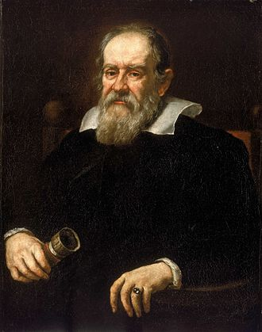
Some history…
Galileo Two New Sciences
Even with a strong scientific process, additional community-level components are required to ensure the validity and credibility of science. These include:
Data recording and sharing
Reproducibility
External review

Slide 28
Consider a model…
…an integrated activity-based model and dynamic traffic assignment model. It accepts and integrates scraped social network communications data.
Data recording and sharing
Reproducibility
External review
→ Is it left on the laptop of a student who left 2 years ago?
→ If you want to add one more variable, how hard is it?
→ Did someone review the model itself, or a description of the model?

Slide 29
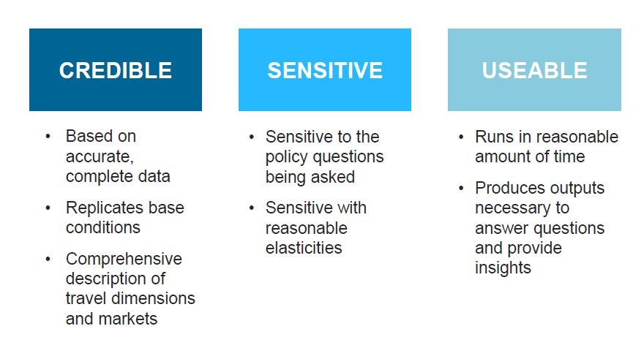
The Freedman Standard
Joel Freedman. “Generative Model of Urban Activities from Cellular Data: A Practioner’s Perspective.” presented at the Transportation Research Board Annual Meeting, Washington, D.C., January 10, 2017.

